Slide 1
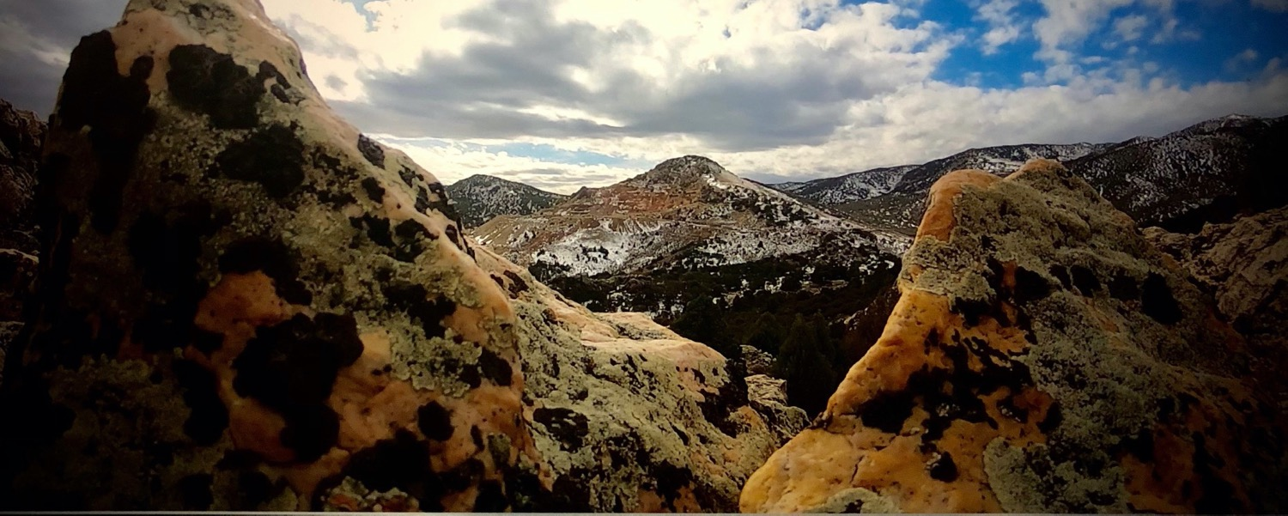

OTCQB: TLRS ǀ TSX.V: TBR
GOLD EXPLORATION
IN THE EUREKA DISTRICT, NEVADA
Exploration Update – NOVEMBER 2022
D I S C O V E R I N G ǀ D E V E L O P I N G ǀ D E L I V E R I N G

Slide 2
CAUTIONARY STATEMENTS
Forward Looking Statements
Statements contained herein that are not based on current or historical fact are forward-looking in nature and constitute forward-looking statements within the meaning of Section 27A of the Securities Act of 1933 and Section 21E of the Securities Act of 1934. Such forward-looking statements reflect the Company’s expectations about its future operating results, performance and opportunities that involve substantial risks and uncertainties. These statements include but are not limited to: statements regarding the Eureka Project resources, exploration targets, and discovery potential, as well as statements regarding future extraction operations. When used herein, the words “anticipate”, “believe”, “estimate”, “upcoming”, “plan”, “target”, “intend”, “growth", and “expect” and similar expressions, as they relate to Timberline Resources Corporation, its subsidiaries, or its management, are intended to identify such forward-looking statements. These forward-looking statements are based on information currently available to the Company and are subject to a number of risks, uncertainties, and other factors that could cause the Company’s actual results, performance, prospects, and opportunities to differ materially from those expressed in, or implied by, these forward-looking statements. Factors that could cause or contribute to such differences include, but are not limited to, risks related to exploration projects, risks related to mining activities, risks related to potential future transactions, risks related to the Company continuing as a going concern, risks related to the ability to finance any payments due, risks related to project development decisions, risks related to mineral resource estimates and other such factors, including risk factors discussed in the Company’s most recent Annual Report on Form 10-K and Quarterly Reports on Form 10-Q. Except as required by Federal Securities law, the Company does not undertake any obligation to release publicly any revisions to any forward-looking statements.
Mineral Resources
Until mineral deposits are actually mined and processed, mineral resources must be considered as estimates only. Mineral resource estimates that are not classified as mineral reserves do not have demonstrated economic viability. The estimation of mineral resources is inherently uncertain, involves subjective judgement about many relevant factors and may be materially affected by, among other things, environmental, permitting, legal, title, taxation, socio-political, marketing, or other relevant risks, uncertainties, contingencies and other factors described in the foregoing Cautionary Statements. The accuracy of any mineral resource estimates is a function of the quantity and quality of available data, and of the assumptions made and judgments used in engineering and geological interpretation, which may prove to be unreliable and depend, to a certain extent, upon the analysis of drilling results and statistical inferences that may ultimately prove to be inaccurate. The quantity and grade of “inferred” mineral resource estimates are uncertain in nature and there has been insufficient exploration to define “inferred” mineral resource estimates as an “indicated” or “measured” mineral resource and it is uncertain if further exploration will result in upgrading “inferred” mineral resource estimates to an “indicated” or “measured” mineral resource category. It cannot be assumed that all or any part of a “inferred”, “indicated” or “measured” mineral resource estimate will ever be upgraded to a higher category including a mineral reserve.
The mineral resource estimates declared by the Company were estimated, categorized and reported using standards and definitions under applicable Canadian securities laws governing the public disclosure of scientific and technical information concerning mineral projects. Accordingly, information describing mineral resource estimates for the Company’s projects may not be comparable to similar information publicly reported in accordance with the applicable requirements of the United States Securities and Exchange Commission, and so there can be no assurance that any mineral resource estimate for the Company’s projects would be the same had the estimates been prepared per such requirements.
For Lookout Mountain resources, refer to Updated Technical Report on the Lookout Mountain Project effective March 1, 2013 and filed on SEDAR April 12, 2013. For Paiute, refer to the Technical Reports effective and filed on SEDAR on November 28, 2018 .
Steven Osterberg, PhD, P.G., Timberline’s Vice President Exploration, is a Qualified Person as defined by NI 43-101 and has reviewed and approved the technical contents of this presentation.

Slide 3
HIGHLIGHTS AND SUMMARY
Timberline is an On-Trend Explorer in Nevada with major land packages, permits in place for extensive drilling, and a foundational resource at the Eureka Project – including high-grade gold at surface and some oxide mineralization
New Water Well Zone discovery is downdip from the existing resource and offers significant growth potential at much higher grades than the existing resource
Nearby Oswego Target includes shallow oxide gold at > 3 g/t that is open in several directions
2022 results include long intervals at > 3 g/t gold from multiple drill holes
Numerous additional drill targets, including the historic Windfall Trend
Timberline believes Eureka has the potential for discovery of >5M oz of gold
Recently completed 6,700m drill program has dramatically improved our 3D understanding of structure and host rocks

Slide 4
CAPITAL STRUCTURE
Capital Structure (as of August 2022) | Common Shares
Common Shares Outstanding | 159.7 M
Options (US$0.20 weighted average exercise price) | 9.3 M
Warrants: (US$0.19 weighted average strike price) | ~61.4M
Fully Diluted | 230 M
Share Ownership | %
Directors and Management | ~16%
Retail Investors | ~40%
Crescat Capital | ~12%
Jupiter Gold & Silver Fund | 9.9%
Market and Financial Information (US$)
Market Capitalization | ~$ 18 M
52-week Closing Price Range | $ 0.09 - $ 0.35
Recent Price | $ 0.10 - 0.15
Cash on Hand | ~$1.0 M

Slide 5
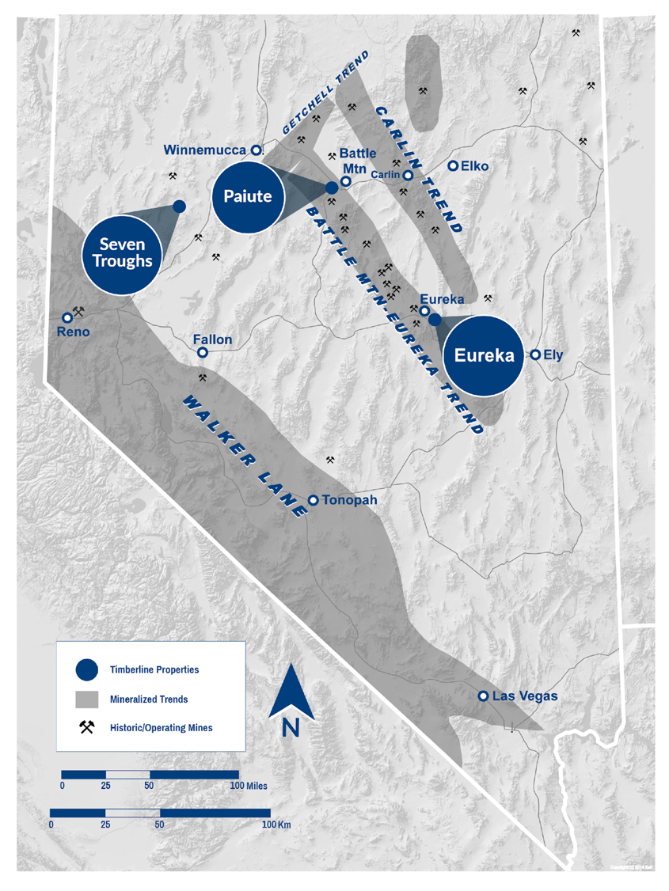
NEVADA FOCUS
LAND OF GIANTS
Nevada: A top-ranked global mining investment jurisdiction
  23 major gold mines, producing 5 million oz. annually
  Second largest gold reserves in the world
  Consistent top-5 ranking in mining investment surveys from Fraser Institute and others
Battle Mountain-Eureka Trend hosts several multi-million-ounce gold districts and mines
Timberline pipeline includes the opportunity for high-grade AND district scale gold plays in three separate projects:
  Eureka: District-scale, advanced exploration with additional early-stage discovery opportunities
  Paiute: Gold porphyry and structural gold targets near Battle Mountain, JV with Nevada Gold Mines
  Seven Troughs: Exploration of historic district for high-grade gold and silver

Slide 6
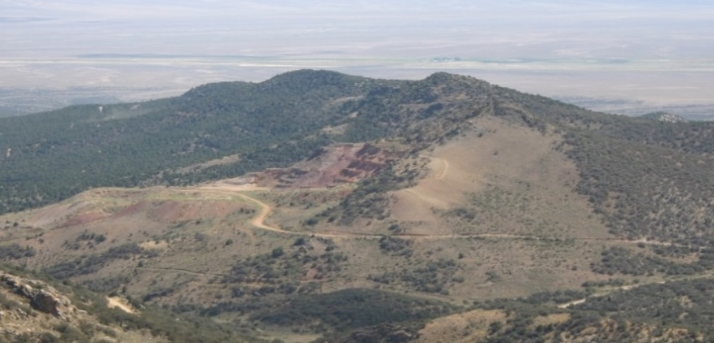
EUREKA PROJECT
Gold Resources at Lookout Mountain Target
Multi-km Strike Carlin-type gold system with associated high-grade trend
E
W
NI 43-101
N-S Gold Resource Trend
High-grade, multi-g/t Au zone
(see slides 10 - 13)
Haul Road
Resource Category | Tonnage (millions short tons) | Grade (oz/ton) | Grade (grams/tonne) | Contained Au⁽¹⁾ (troy oz)
Measured | 3.04 | 0.035 | 1.20 | 106,000
Indicated | 25.90 | 0.016 | 0.55 | 402,000
Measured + Indicated | 28.94 | 0.018 | 0.62 | 508,000
Inferred | 11.71 | 0.012 | 0.41 | 141,000
⁽¹⁾ Refer to Updated Technical Report on the Lookout Mountain Project, MDA, Effective March 1, 2013, Filed on SEDAR April 12, 2013

Slide 7
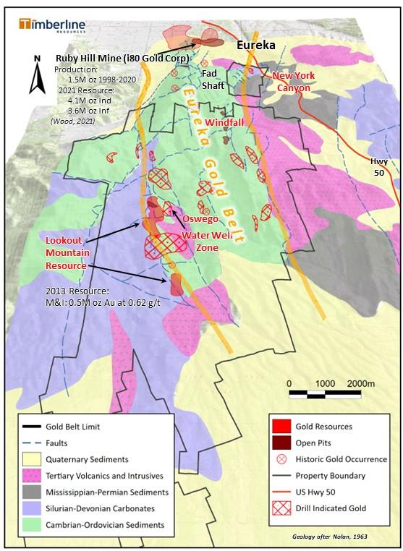
EUREKA DISTRICT
Major Claim Owner in a 10M Oz Gold District
District-scale: 27 mi² (70 km²) land package remains largely under-tested; multiple target areas
  On-trend from former Barrick Ruby Hill Gold Mine (now i80 Gold)
Eureka Gold Belt defined by multiple Carlin-type gold systems in Cambrian - Ordovician rocks spanning >16km from Ruby Hill Mine to Lookout Mtn Resource and beyond
Lookout Mountain Trend:
  At surface oxide resource in place⁽¹⁾
      Associated high-grade gold zone (> 3 g/t) beneath the historic pit and downdip into the Water Well Zone; open for expansion along strike and at depth
      Permitted for more than 250 drill sites
Oswego Target:
  High-grade oxide gold at surface in channel samples with recently reported drill-indicated gold down dip
Windfall Target:
  Historic open pit gold production (115,000 oz., run-of-mine heap leach) with drill indicated gold along trend
¹For resource details, refer to Updated Technical Report on the Lookout Mountain Project, MDA, Effective March 1, 2013, Filed on SEDAR April 12, 2013
7
7

Slide 8
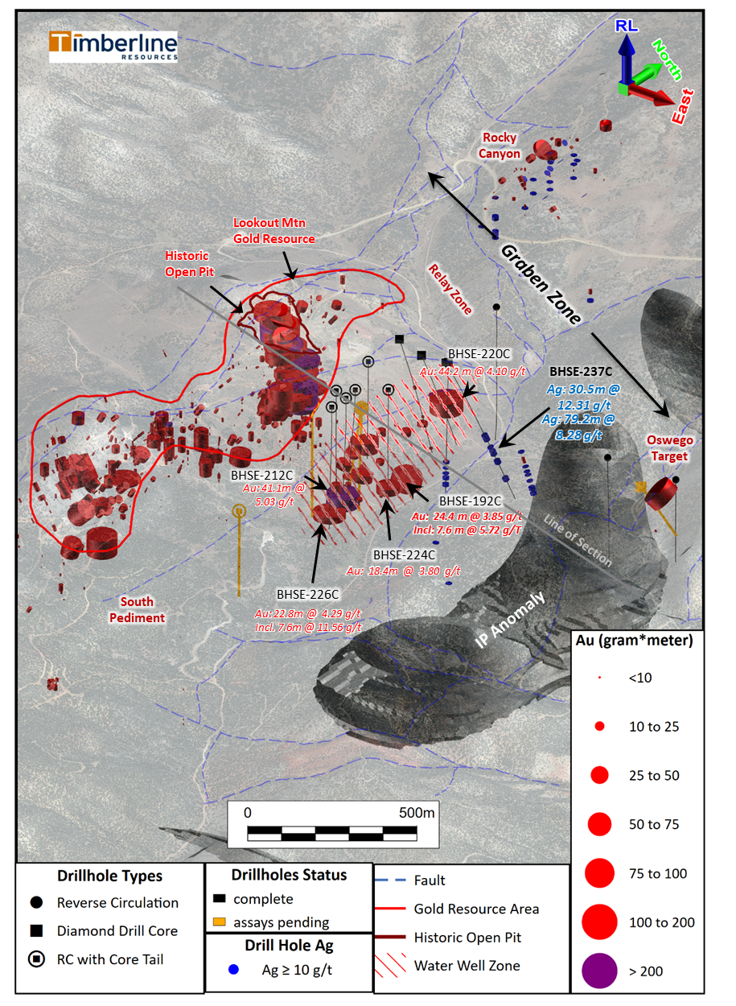
LOOKOUT MOUNTAIN AND WATER WELL ZONE
3D Perspective of High-Grade Drilling and Targets
Multiple mineral systems linked to major N-S structural corridor with high-grade gold at surface on west (Lookout) and east (Oswego)
  ~8km strike along Lookout Trend
  Large IP anomaly spanning at least 2.5km
  First tests of IP anomaly hit sulfide, gold, and silver
  Strong evidence for older carbonate replacement deposit (CRD) style of silver-dominant mineralization beneath the Carlin type gold
Lookout Mountain Trend:
  ONLY portion of the 4.5km trend that is properly drilled yielded significant high-grade and down-dip WWZ discovery
  At surface gold resource in place – containing some oxide⁽¹⁾
      Associated High-grade Gold Zone (> 3 g/t); recently drilled, open for expansion along strike and at depth
      Water Well Zone = downdip roots of Lookout Deposit
      Permitted for more than 250 drill sites
Oswego Trend:
  Surface showing with >80m of +12 g/t oxide gold at surface
  Open to north and downdip
  Major N-S faults controlling high grade gold are continuous for >4km
  Significant downdip targets as major fault cuts favorable host rocks
¹For resource details, refer to Updated Technical Report on the Lookout Mountain Project, MDA, Effective March 1, 2013, Filed on SEDAR April 12, 2013

Slide 9
LOOKOUT MOUNTAIN RESOURCE AREA
Detail Geologic Cross Section
Oswego Target
Surface Rock Chips:
86m of 12.4 g/t Au
Jasperoid alteration at surface shown in Lookout Resource Area
IP chargeability anomaly related to sulfides and carbon cutting favorable host rocks and east-dipping faults

Slide 10
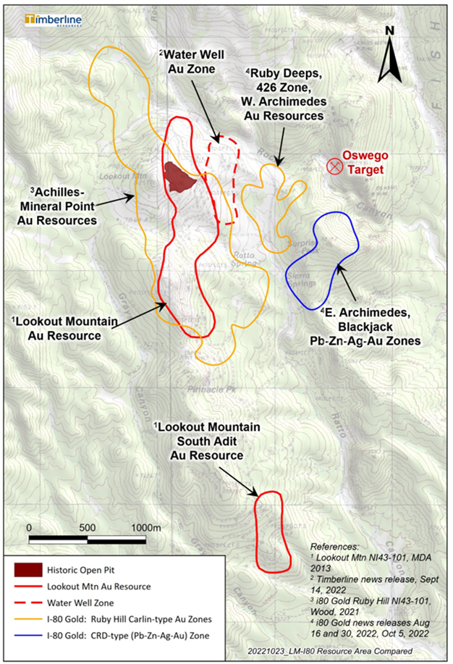
FOOTPRINTS OF DISCOVERY
Ruby Hill & Lookout Mtn Discoveries
Surface projections¹ of i80 Gold and Timberline resources and drill-indicated gold and silver zones
There is “room” for multi-million-ounce discoveries in the Lookout Mountain to Oswego corridor
Timberline’s focus since 2020 has been North Lookout and Water Well Zone – a small percentage of the prospective target area
Timberline’s Lookout Mountain Resources:
0.51M oz of Au at 0.62 g/t (M & I)
i80 Gold’s Ruby Deeps Resources:
1.59M oz of Au at 6.02 g/t (Inferred)
i80 Gold’s 426 Zone Resources:
0.20M oz of Au at 5.22 g/t (Indicated)
i80 Gold’s Mineral Point Resources:
3.21M oz of Au at 0.49 g/t (Indicated)
1.87M oz of Au at 0.37 g/t (Inferred)
Surface Projections of i80 Gold and Timberline Targets
** For Scale Comparison Only **
10
¹ – Compared at scale from each company’s public materials
10

Slide 11
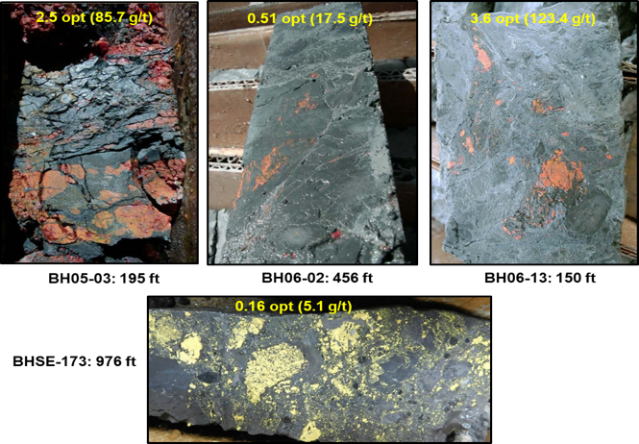
LOOKOUT MOUNTAIN TREND
ON THE TRAIL OF HIGH GRADE
Lookout Mountain and WWZ: Selected High-Grade Gold Intercepts⁽¹⁾
Drill Hole | From (feet) | Length (feet) | Gold (opt) | From (meters) | Length (meters) | Gold (g/t)
BH06-10 | 0 | 50 | 0.537 | 0 | 15.2 | 18.42
BH05-01 | 270 | 65 | 0.344 | 82.3 | 19.8 | 11.79
including | 275 | 25 | 0.641 | 83.8 | 7.6 | 21.98
BR-19 | 385 | 75 | 0.283 | 117.4 | 22.9 | 9.7
BHSE-029C | 391 | 58 | 0.349 | 119.2 | 17.7 | 11.95
BH06-07 | 406 | 92 | 0.217 | 123.8 | 28 | 7.44
BHSE-212C | 1,037 | 135 | 0.147 | 316.1 | 41.1 | 5.03
including | 1,042 | 65 | 0.277 | 317.6 | 19.8 | 9.49
BHSE-220C | 462 | 145 | 0.120 | 140.8 | 44.2 | 4.10
including | 462 | 75 | 0.182 | 140.8 | 22.9 | 6.24
including | 497 | 40 | 0.268 | 151.5 | 12.2 | 9.18
BHSE-176 | 70 | 50 | 0.294 | 21.34 | 15.24 | 10.09
BHSE-126C | 31 | 15 | 0.967 | 9.5 | 4.6 | 33.15
BH06-16 | 0 | 33 | 0.376 | 0 | 10 | 12.88
BH06-02 | 445 | 27 | 0.364 | 135.7 | 8.2 | 12.48
BHSE-226C | 1115 | 75 | 0.125 | 339.9 | 22.8 | 4.29
BHSE-151C | 506 | 9 | 1.023 | 154.3 | 2.7 | 35.07
BHSE-192C | 1,147 | 80 | 0.112 | 349.6 | 24.4 | 3.85
BHSE-224C | 1,042 | 100 | 0.075 | 317.6 | 30.5 | 2.56
BHSE-172 | 900 | 40 | 0.136 | 274.3 | 12.2 | 4.66
BH06-13 | 148 | 3 | 1.47 | 45.1 | 0.9 | 50.4
BHSE-187 | 875 | 25 | 0.222 | 266.7 | 7.62 | 4.49
BHSE-186 | 15 | 20 | 0.152 | 4.57 | 6.1 | 5.21
Drill thickness - True widths of intercepts have not been determined Red intervals were reported from 2020 - 2021 drilling program
Recognition of high-grade gold zone associated with favorable stratigraphy and major structural zone, often oxidized at Lookout Mountain
Carbonaceous and siliceous breccias hosting majority of high-grade at Water Well Zone
Introduction of gold with sooty sulfides and As, Sb, Hg, Tl, and Zn pathfinder elements
¹Refer to Updated Technical Report on the Lookout Mountain Project, MDA, Effective March 1, 2013, Filed on SEDAR April 12, 2013 and numerous Company news releases

Slide 12
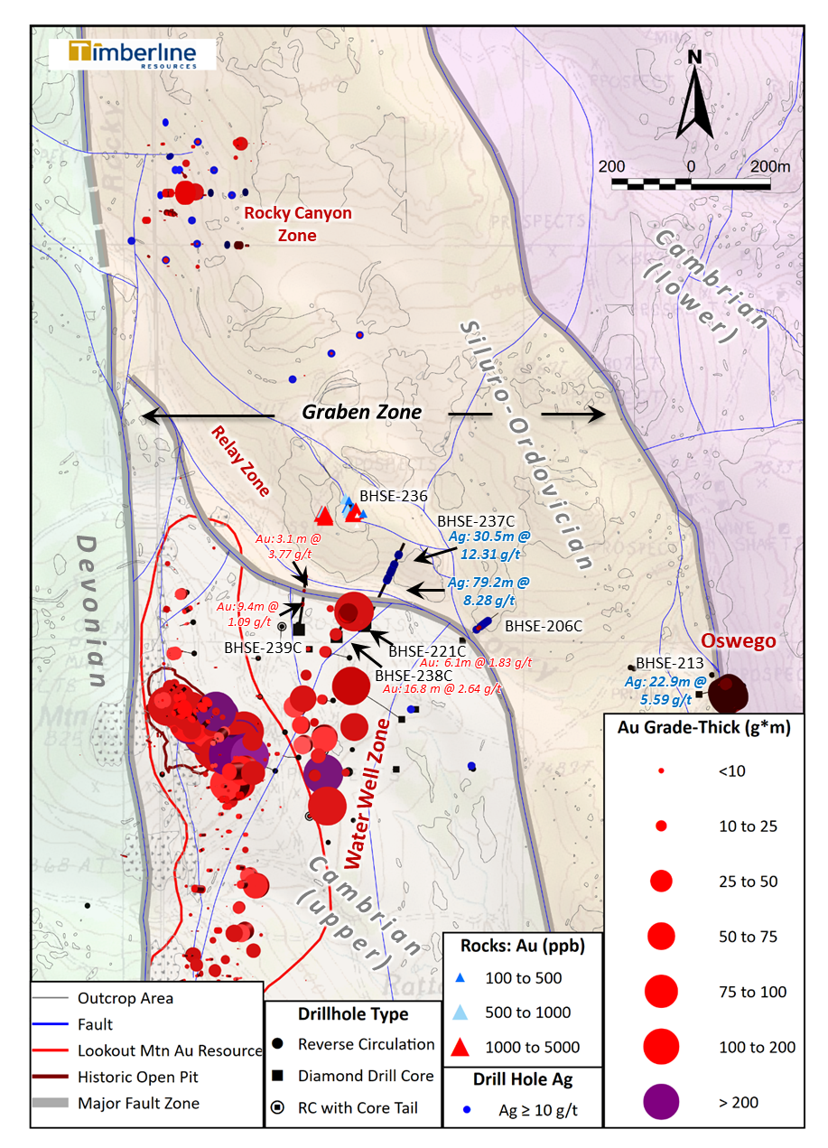
Latest Updates from 2022 Drilling
Infill of WWZ and multiple tests of its margins and internal structures
RC pre-collars and core drilling to address sampling issues beneath the water table – tests confirm improved results from core
Thicker and higher-grade intercepts from recent core drilling better define the potential of the Water Well Zone (Holes 192, 212, 220, and 226)
Faulting has offset and created apparent gaps, but Dunderberg – Hamburg contact remains consistently mineralized
Significant Ag-rich CRD system with intrusive rocks repeatedly drilled to north of WWZ
Improved 3D model
Sections

Slide 13
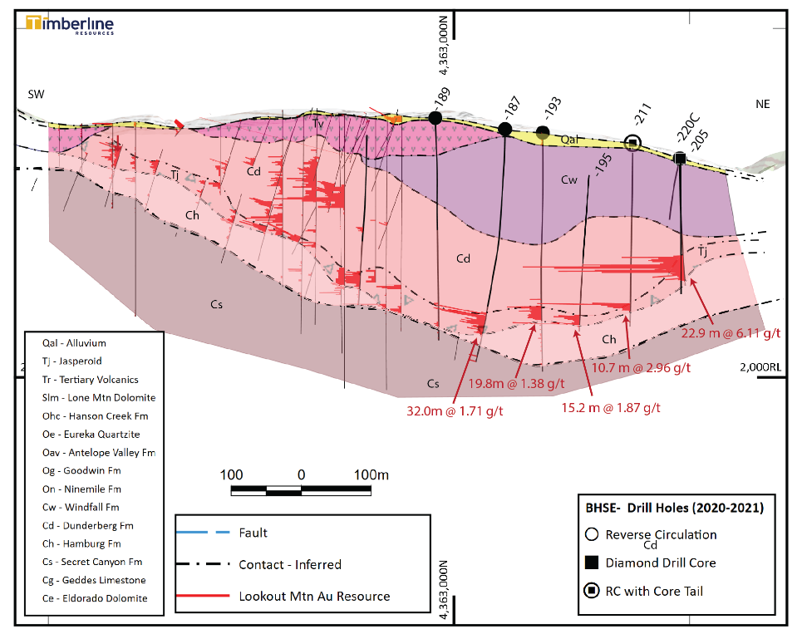
LOOKOUT RESOURCE TO WATER WELL ZONE
SSW-NNE Long Section Showing Resource and New Discovery Area
Dunderberg Shale is dominant host in both resource and WWZ
WWZ is downdip from resource
Water Well Zone is consistently mineralized at base of Dunderberg over a large area
Target zone varies in depth with faulting and folding (?) – as shallow as 140m in the north
Host horizon varies in thickness - averaging more than 18m of mineralization
Best hole to date at south WWZ is not shown – outside section
Resource Area
Water Well Zone
? Major Fault ?
39m at 1.71 g/t
RC intercepts just confirmed and improved with core

Slide 14
IMPORTANT GOLD CONTROLLING STRUCTURES
Key Structures in the Water Well Zone
Upthrown block
Major fault intersection
?
Undrilled deeper blocks
(Coincident with IP anomaly)
?
Trough or collapse block
(Uncertain fault control)
?

Slide 15
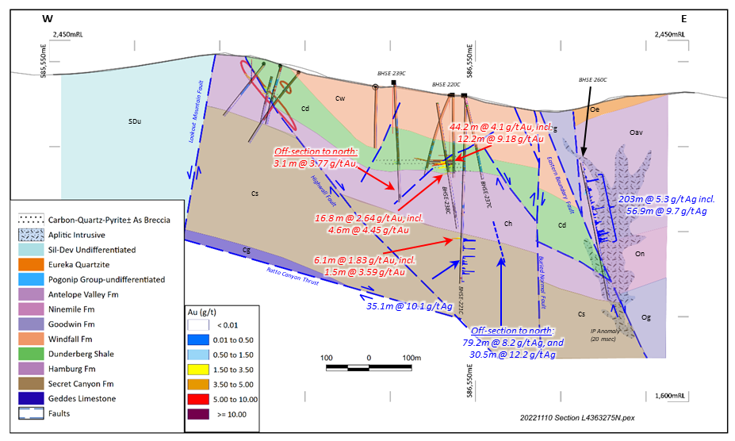
WWZ HIGH GRADE ZONE – OPEN TO NORTH
Intersecting new structures with controls on gold and confirming
presence of CRD (Ag-Pb-Zn) system
DRAFT Geologic Cross Section through Northern WWZ Looking North
Resource Area
Structural High:
an important control on high-grade gold

Slide 16
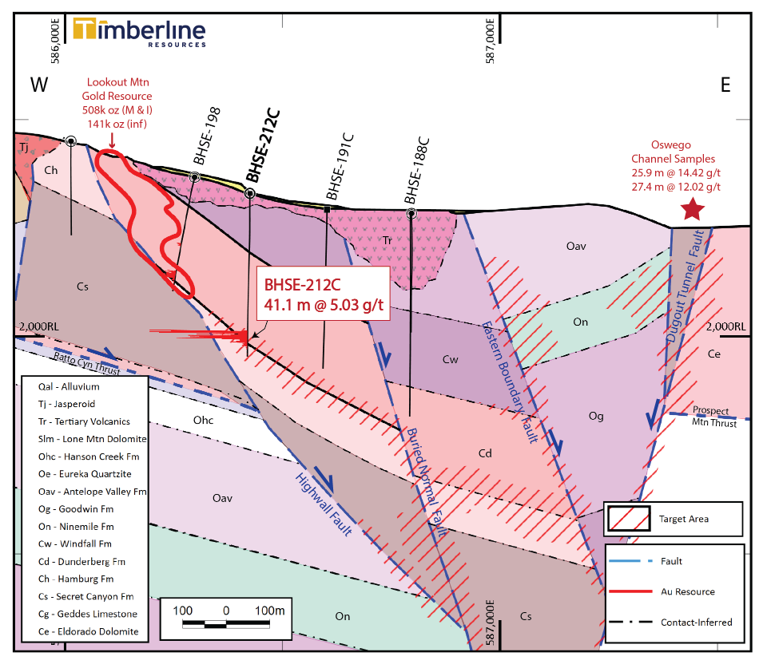
WWZ HIGH GRADE ZONE OPEN TO SOUTH
Geologic Cross Section through Resource and Southern Water Well Zone
BHSE-212C is richest hole to date in the WWZ, includes:
    19.8m at 9.49 g/t Au
    6.1m at 16.90 g/t Au
Well developed Carlin-style alteration at the base of Dunderberg and top of Hamburg
Wide open to south and east – earlier drill holes did not test host horizon
Resource up-dip to the west and structural corridor with IP anomaly to the east
Newest intercept – 22.8m at 4.29 g/t Au 75m south of section, more step-outs coming in 2022
Looking North

Slide 17
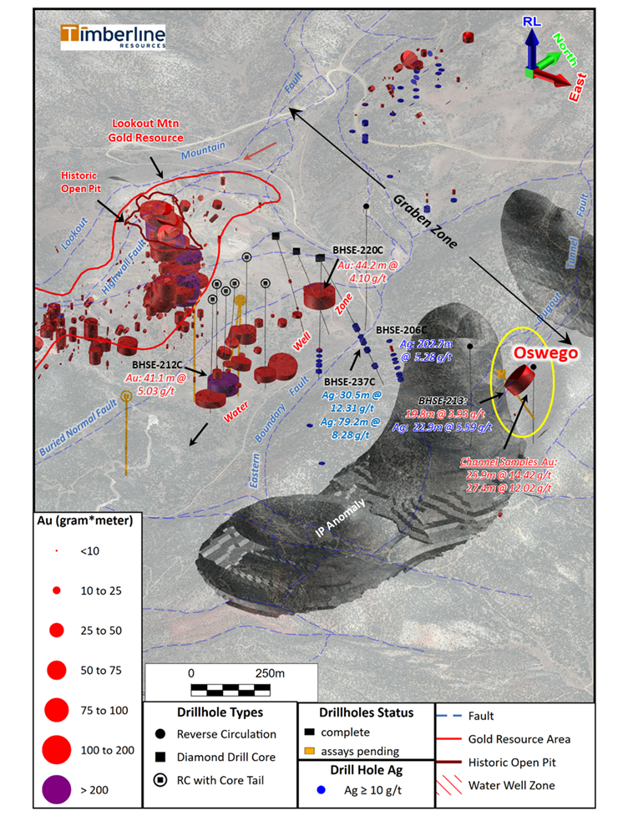
OSWEGO AND THE GRABEN ZONE
New Discoveries at Oswego and in the Graben may be related to Lookout - WWZ
Timberline developed a new model for the structural corridor dubbed the Graben Zone
Major faults controlling gold on both sides of the valley – cored by IP anomaly with older intrusive rocks and silver-lead-zinc
2021 channel sampling and drilling at Oswego encountered high-grade (oxide) gold - only 1km east of the Water Well Zone
Highlight from 2021 drilling: 35.1m at 2.32 g/t Au, including 19.8m at 3.93 g/t Au (oxide)
Emphasis for 2022 is on testing the Oswego discovery to the north and down dip

Slide 18
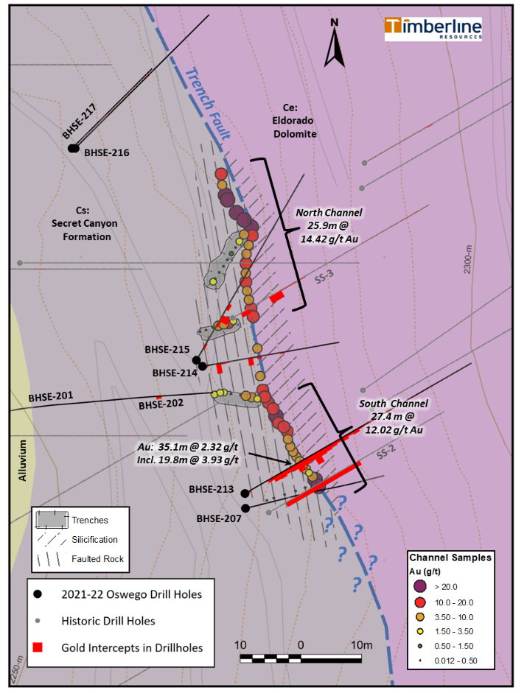
OSWEGO TARGET
Geologic Map with Channel Sample and
Drill Hole Results
First mechanized exploration in 30 years - channel samples along the fault scarp and trenches across the fault plus 8 RC drill holes
Timberline located and surveyed historic holes during 2021 and incorporated into new detailed mapping
NO internal waste in the channel samples among the contiguous 1.5-metre samples
2021 drilling cut the fault zone in multiple places, thick oxide interval was the highlight:
35.1m at 2.32 g/t Au, including 19.8m at 3.93 g/t
Multiple intercepts on the structure – open to the north and downdip - best host rocks occur at depth along structure

Slide 19
OSWEGO RC Drilling

Slide 20
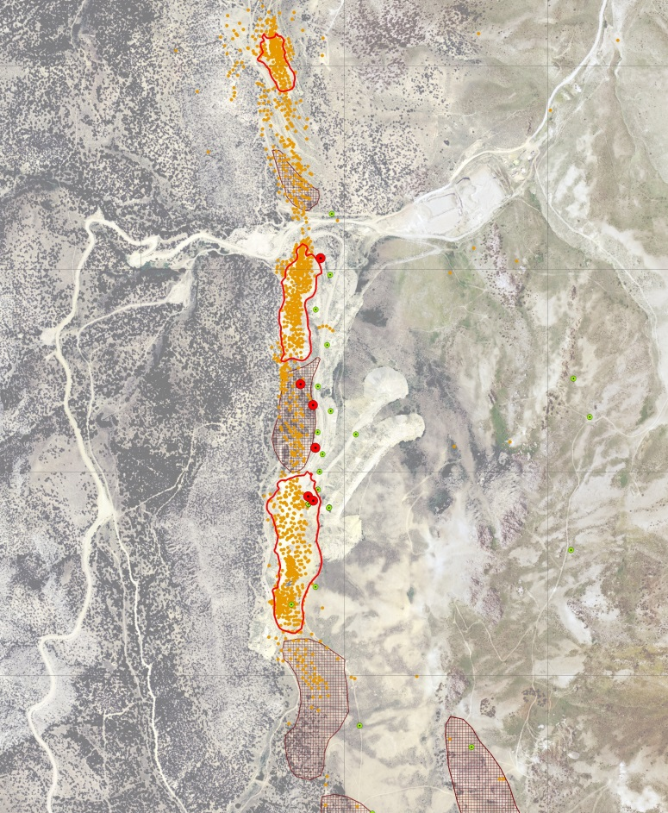
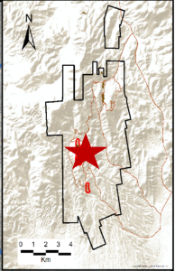
EUREKA PROPERTY: WINDFALL TARGET MAP
Historic Production and Modern Drill Intercepts
Recent Golden Lake Results:
67.57m at 2.37 g/t Au, including
26.37m at 5.38 g/t Au
South Paroni Pit:
~31,800 Ounces Produced
BHWF-038
24.4 m @ 0.32 g/t
Windfall Pit:
32,077 Ounces Produced
100% Timberline Ownership (patented claims)
Windfall Mine (1975-1984)
  Among industry’s first stand-alone open pit heap leach operations
  Excellent historic gold leach recovery on Run-of-Mine ore
2.7 km major structural zone with coincident gold mineralization
Gold occurs at contact of Dunderberg Shale and Hamburg Dolomite
Timberline drill intercepts beneath and between pits, plus new IP anomalies to east and west
BHWF-037
27.4 m @ 2.20 g/t incl.
13.7 m @ 3.68
BHWF-040
24.4 m @ 3.04 g/t incl.
6.1 m @ 8.79
W
E
BHWF-041
18.3 m @ 1.24 g/t
BHWF-036
12.2 m @ 1.26 g/t
BHWF-039
10.7 m @ 0.46 g/t
N
Rustler Pit:
~50,000 Ounces Produced
400 m
1,500 ft

Slide 21
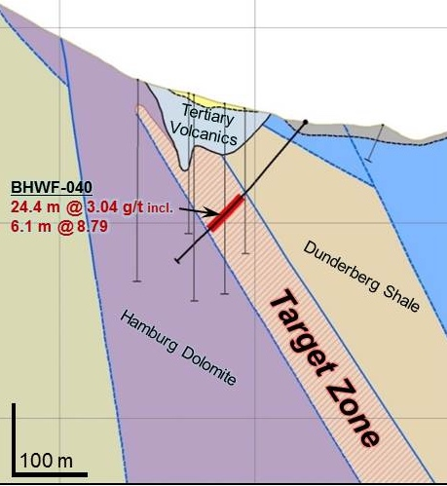
EUREKA PROPERTY: WINDFALL TARGET
Gold Mineralization: Drilling and Surface Sampling
40 gold-bearing surface samples⁽²⁾ within and south of historic Windfall Pit
  maximum 13.1 g/t (0.382 opt)
  6 samples >3.0 g/t (0.088 opt)
  10 samples >1.0 g/t (0.029 opt)
  17 samples >0.25 g/t (0.007 opt)
Drill Hole | From (feet) | Length⁽¹⁾ (feet) | Gold (oz/ton) | From (meters) | Length (meters) | Gold (g/t)
BHWF-036 | 290 | 40 | 0.04 | 88.4 | 12.2 | 1.26
BHWF-037 | 185 | 90 | 0.06 | 56.4 | 27.4 | 2.20
including | 185 | 45 | 0.11 | 56.4 | 13.7 | 3.68
BHWF-040 | 290 | 80 | 0.09 | 88.4 | 24.4 | 3.04
including | 305 | 20 | 0.26 | 93.0 | 6.1 | 8.79
BHWF-041 | 230 | 60 | 0.04 | 70.1 | 18.3 | 1.24
W
E
Surface Sample⁽²⁾ | Gold (oz/ton) | Gold (g/t) |  | Surface Sample | Gold (oz/ton) | Gold (g/t)
18WF-009 | 0.05 | 1.72 |  | 18WF-047 | 0.225 | 7.71
18WF-011 | 0.031 | 1.05 |  | 18WF-049 | 0.008 | 0.275
18WF-013 | 0.036 | 1.25 |  | 18WF-051 | 0.011 | 0.386
18WF-034 | 0.009 | 0.303 |  | 18WF-053 | 0.018 | 0.61
18WF-035 | 0.088 | 3.02 |  | 18WF-054 | 0.089 | 3.06
18WF-036 | 0.382 | 13.1 |  | 18WF-055 | 0.094 | 3.22
18WF-037 | 0.021 | 0.711 |  | 18WF-056 | 0.074 | 2.52
18WF-039 | 0.012 | 0.408 |  | 18WF-062 | 0.119 | 4.08
18WF-041 | 0.027 | 0.927
*Assays were determined by ALS USA Inc. from grab samples. The samples were crushed and pulverized and a fraction was selected for analyses. Gold was determined by 30 g Fire Assay with an Atomic Absorption finish. Samples assaying over 10g/t gold were re-assayed and completed with a gravimetric finish.
Cross-section between Rustler and Windfall Pits
¹ see Press Release dated April 20, 2015 for additional detail; true widths of the drill intercepts have not been determined
² see Press Release dated August 8, 2018 for additional detail

Slide 22
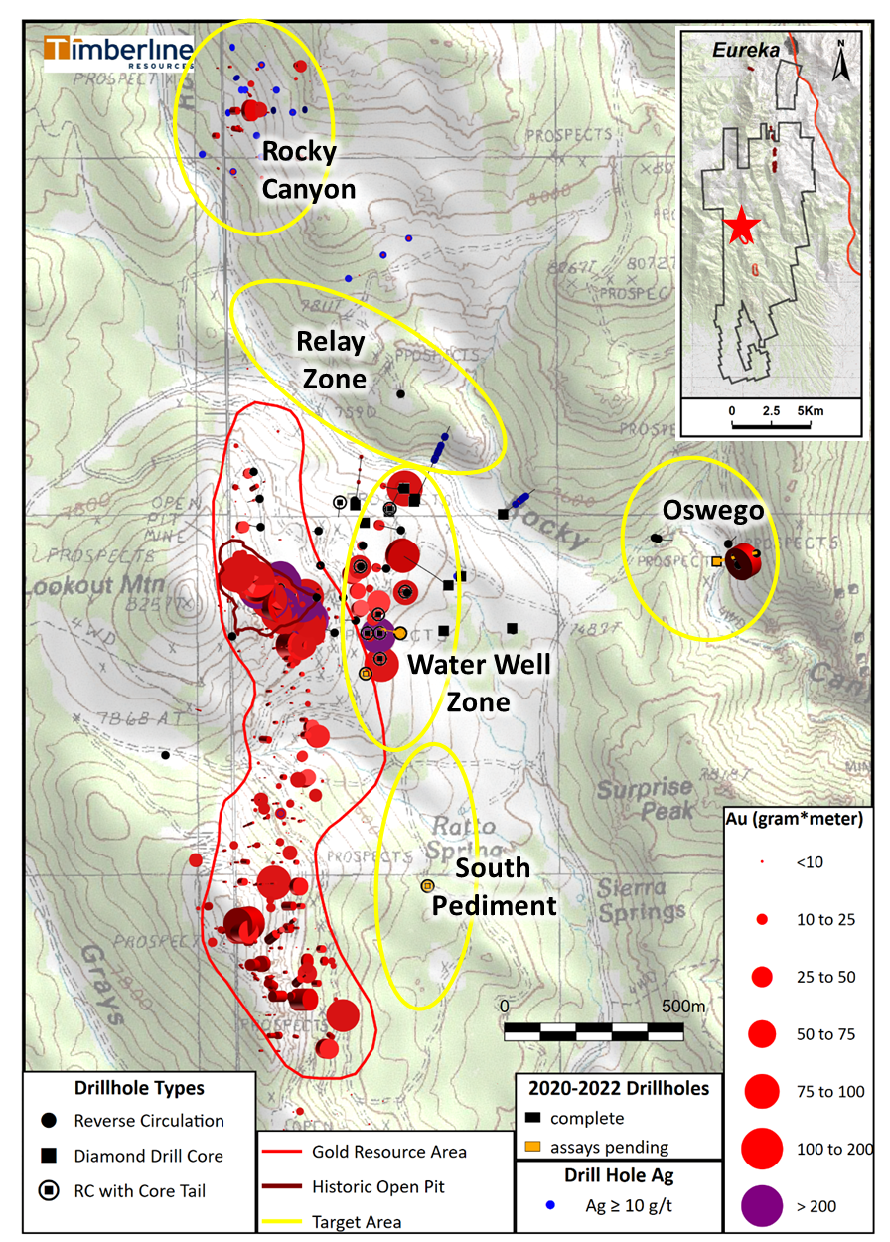
EUREKA UPDATE:
2022 Drill Program
Approximately 6,700m of drilling completed
  4,600m of core
  2,100m of RC
Drilling completed in late October with up to 2 rigs
  ~20 holes recently completed
  Under budget on costs
Focus on Water Well Zone and Step-outs
  80% of focus
  High-grade zones at north and south are priority
  In-fill drilling at the WWZ, including more RC twins
  Big step-outs into South Pediment and Relay Targets completed
Oswego Target will constitute 10 – 15%
First results reported in September, multiple news releases expected in November - December

Slide 23
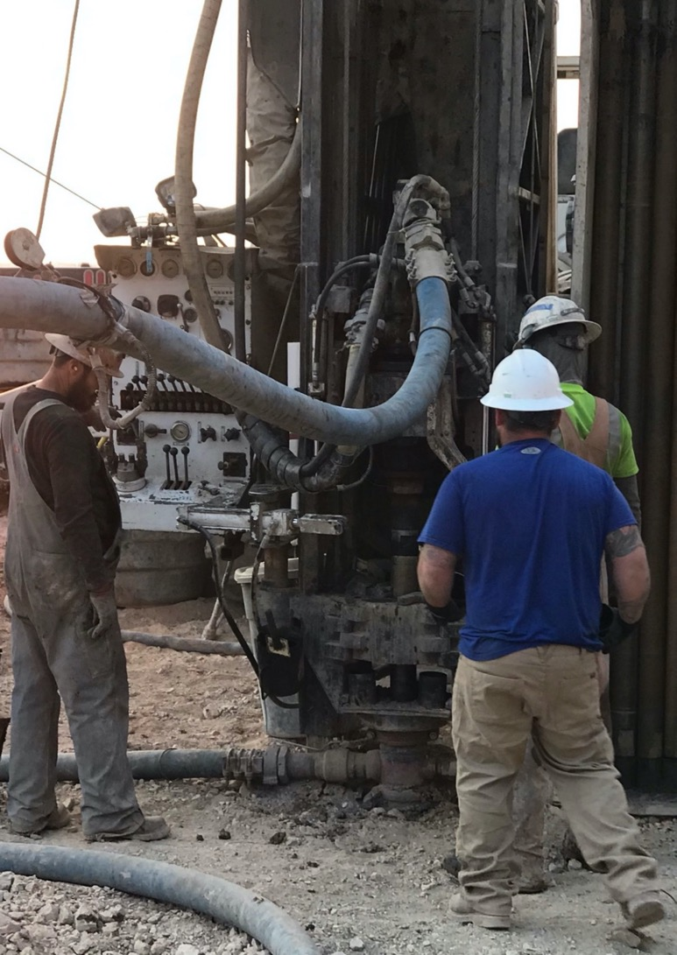
THANK-YOU
PATRICK HIGHSMITH
PRESIDENT & CEO
P H O N E 2 0 8 . 6 6 4 . 4 8 5 9
EMAIL: highsmith@timberline–resources.com
WEBSITE: TIMBERLINE–RESOURCES.COM

