Slide 1
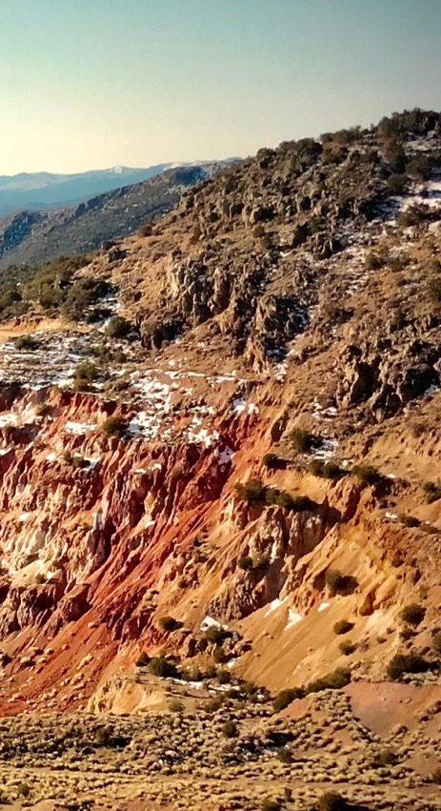
OTCQB: TLRS | TSX.V: TBR
BIG PICTURE POLYMETALLIC POTENTIAL IN THE EUREKA DISTRICT, NEVADA
DECEMBER 2023
D I S C O V E R I N G ǀ D E V E L O P I N G ǀ D E L I V E R I N G

Slide 2
CAUTIONARY STATEMENTS
Forward Looking Statements
Statements contained herein that are not based on current or historical fact are forward-looking in nature and constitute forward-looking statements within the meaning of Section 27A of the Securities Act of 1933 and Section 21E of the Securities Act of 1934. Such forward-looking statements reflect the Company’s expectations about its future operating results, performance and opportunities that involve substantial risks and uncertainties. These statements include but are not limited to: statements regarding the Eureka Project resources, exploration targets, and discovery potential, as well as statements regarding future extraction operations. When used herein, the words “anticipate”, “believe”, “estimate”, “upcoming”, “plan”, “target”, “intend”, “growth", and “expect” and similar expressions, as they relate to Timberline Resources Corporation, its subsidiaries, or its management, are intended to identify such forward-looking statements. These forward-looking statements are based on information currently available to the Company and are subject to a number of risks, uncertainties, and other factors that could cause the Company’s actual results, performance, prospects, and opportunities to differ materially from those expressed in, or implied by, these forward-looking statements. Factors that could cause or contribute to such differences include, but are not limited to, risks related to exploration projects, risks related to mining activities, risks related to potential future transactions, risks related to the Company continuing as a going concern, risks related to the ability to finance any payments due, risks related to project development decisions, risks related to mineral resource estimates and other such factors, including risk factors discussed in the Company’s most recent Annual Report on Form 10-K and Quarterly Reports on Form 10-Q. Except as required by Federal Securities law, the Company does not undertake any obligation to release publicly any revisions to any forward-looking statements.
Mineral Resources
Mineral resource estimates that are not classified as mineral reserves do not have demonstrated economic viability. The estimation of mineral resources is inherently uncertain, involves subjective judgement about many relevant factors and may be materially affected by, among other things, environmental, permitting, legal, title, taxation, socio-political, marketing, or other relevant risks, uncertainties, contingencies and other factors described in the foregoing Cautionary Statements. The accuracy of any mineral resource estimates is a function of the quantity and quality of available data, and of the assumptions made and judgments used in engineering and geological interpretation, which may prove to be unreliable and depend, to a certain extent, upon the analysis of drilling results and statistical inferences that may ultimately prove to be inaccurate.
A technical report entitled, Technical Report on the Lookout Mountain Project, Eureka County, Nevada, USA, compliant with Canadian NI 43-101 (“2013 Technical Report”), was completed on March 1, 2013. The 2013 Technical Report was prepared by Mine Development Associates (MDA) of Reno, Nevada under the supervision of Michael M. Gustin, Senior Geologist, who is a qualified person under NI 43-101. The Technical Report details mineralization at the Lookout Mountain Deposit. In addition, significant exploration potential was noted.
Subsequent to the filing of the Company’s Annual Report on Form 10-K on December 29, 2022, we re-engaged Mr. Gustin, most recently of RESPEC, to provide an updated report and summary to meet the standards of US Securities and Exchange Commission (SEC) Regulation S-K Subpart 1300. This technical report is entitled S-K 1300 Technical Report Summary: Lookout Mountain Project, Eureka Property, Eureka, Nevada and is dated June 21, 2023, with an effective date of December 31, 2022. The S-K 1300 report updates the previous gold resource calculation to include the potential amenability of the resource to mining by open pit methods.
For Lookout Mountain resources, refer to the Company’s S-K 1300 Technical Report Summary on the Lookout Mountain Project dated June 21, 2023 and filed on EDGAR July 2023. For Paiute, refer to the NI-43-101 Technical Report, effective and filed on SEDAR on November 28, 2018 .
Steven Osterberg, PhD, P.G., Timberline’s Vice President Exploration, is a Qualified Person as defined by NI 43-101 and has reviewed and approved the technical contents of this presentation.
2

Slide 3
HIGHLIGHTS & SUMMARY
Timberline is an On-Trend Explorer in Nevada with major land packages, permits in place for extensive drilling, and high-grade polymetallic exploration targets
District-scale Eureka Property includes significant potential for Carlin-type gold (CTG) and CRD-type silver-lead-zinc deposits
High-grade gold and silver in rock chips at New York Canyon is an exciting new target for both CRD silver and Carlin-type gold mineralization
New Water Well Zone discovery is downdip from the existing gold resource and offers significant growth potential at much higher grades than the existing resource
2022 results included long intervals at > 3 g/t gold from multiple holes at WWZ
Lookout Mountain resource recently upgraded and advancing to permitting stage
Timberline controls southern part of Eureka District, while i80 Gold Corp advances the northern part of the district towards new mines

Slide 4
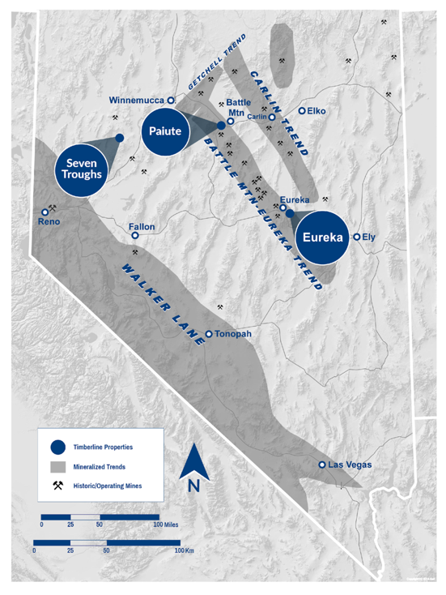
NEVADA FOCUS LAND OF GIANTS
Nevada: A top-ranked global mining investment jurisdiction
23 major gold mines, producing 5 million oz. annually
Second largest gold reserves in the world
Consistent top-5 ranking in mining investment surveys from Fraser Institute and others
Battle Mountain-Eureka Trend hosts several multi-million-ounce gold districts and mines
Timberline pipeline includes the opportunity for high-grade AND district scale gold plays in three separate projects:
Eureka: District-scale, advanced exploration with additional early-stage discovery opportunities
Paiute: Gold porphyry and structural gold targets near Battle Mountain, jointly owned with Nevada Gold Mines
Seven Troughs: Exploration of historic district for high-grade gold and silver
4

Slide 5
CAPITAL STRUCTURE
Capital Structure (as of September 2023) | Common Shares
Common Shares Outstanding | 174.2 M
Options (US$0.18 weighted average exercise price) | 6.0 M
Warrants: (US$0.15 weighted average strike price) | 45.7 M
Fully Diluted | 225.9 M
Share Ownership | %
Directors and Management | 15%
Retail Investors | ~40%
Crescat Capital | 15%
Jupiter Gold & Silver Fund | 14%
Market and Financial Information (US$)
Market Capitalization | ~$ 8 M
52-week Closing Price Range | $ 0.04 - $ 0.16
Recent Price | $ 0.04 - $0.06
5

Slide 6
BOARD AND MANAGEMENT
Patrick Highsmith, President, CEO & Director
Over 30 years of international experience including operational, exploration, and business development roles with Newmont Mining, BHP, Rio Tinto, and Fortescue Metals Group
Director and senior executive in several junior companies including Lithium One, Bellhaven Copper & Gold, Pure Energy Minerals, Champion Electric Metals, and FireFox Gold
Steven Osterberg, Ph.D., P.G., Vice President Exploration
Over 30 years of gold and base metals exploration, permitting, development, closure, and management experience
Senior technical and management positions with junior to major mining groups, as well as engineering and consulting firms, including BHP Minerals, Knight Piésold, and Tetra Tech
Leigh Freeman, Director, Chairman
Over 35 years of mining industry experience in technical and executive positions, including former chief geophysicist Placer Dome, co- founder/CEO of Orvana Minerals, and former CEO of Blue Sun Energy
Advisor to Montana Tech, University of Arizona, and South Dakota School of Mines
Ted Sharp, C.P.A., Chief Financial Officer
President of Sharp Executive Associates, Inc., a privately held firm which provides CFO services to the exploration and mining resource sector
14 years in positions of CFO, Managing Director of European Operations, and Corporate Controller for Key Technology, Inc., a publicly traded manufacturer of capital goods.
William Matlack, Director
Over 20 years in precious metals exploration with Gold Fields and Santa Fe Pacific Gold Corp.
Equity research analyst with Citigroup and BMO Capital Markets
Director and Interim CEO of Klondex Mines during transformation from explorer to gold producer
Donald McDowell, Director
Over 30 years of mining-related exploration, property evaluation, and resource development primarily in Nevada, including 17 years with majors (Santa Fe Pacific Gold, Kennecott, Nippon Mining)
Founder of Americas Gold Exploration Inc. dedicated to exploration in Nevada, including instrumental role in the Carlin Vanadium deposit
Pamela Saxton, C.P.A., Director
An accredited accountant with over 35 years international and domestic experience in mining, oil and gas, and software industries.
Senior leadership roles at Thompson Creek Metals, J.D. Edwards & Co., Amax Gold, New West Gold, Franco Nevada, and Pershing Gold.
Led major financings of over $2B to fund construction and development of Mt. Milligan Mine, multiple IPOs, and corporate transactions.
6

Slide 7
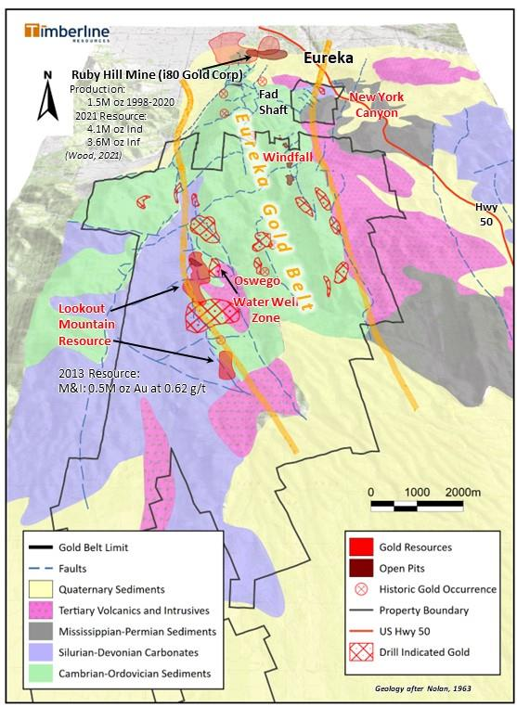
EUREKA DISTRICT
Major Claim Owner in an Emerging World Class Gold & Silver District
District-scale: 27 mi² (70 km²) land package remains largely under-tested; multiple target areas on trend from i80 Gold’s Ruby Hill Project
Eureka Gold Belt defined by multiple Carlin-type gold systems in Cambrian - Ordovician rocks spanning >16km from Ruby Hill Mine to Lookout Mtn Resource
Lookout Mountain Trend (permitted for 250+ drill sites):
At surface oxide resource in place⁽¹⁾
Associated high-grade gold zone (> 3 g/t) beneath the historic pit and downdip into the Water Well Zone; open for expansion along strike and at depth
New York Canyon Target (patented claims):
High-grade gold and silver at surface in rock samples
CRD-style Ag-Pb-Zn and Carlin-type Au
Windfall Target (patented claims):
Historic open pit gold production (115,000 oz., run-of-mine heap leach) with drill indicated gold along trend
CRD target downdip and present along parallel Hoosac structure
Oswego Target (patented claims):
High-grade oxide gold at surface in channel samples and in limited drilling
CRD mineralization in historic mines and showings to the north
¹For resource details, refer to Updated Technical Report on the Lookout Mountain Project, MDA, Effective March 1, 2013, Filed on SEDAR April 12, 2013
7
7

Slide 8
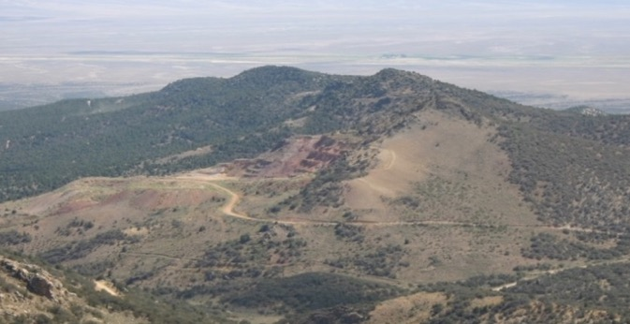
EUREKA PROJECT Pit Constrained Gold Resource⁽¹⁾ at Lookout Mountain Project
E
W
N-S Gold Resource Trend
East dipping rocks
Water Well Zone
Haul Road (1980s)
Haul Road
Resource Category | Tonnage (millions short tons) | Grade (oz/ton) | Grade (grams/tonne) | Contained Au⁽¹⁾(troy oz)
Measured | 2.55 | 0.036 | 1.23 | 93,000
Indicated | 23.27 | 0.014 | 0.48 | 330,000
Measured + Indicated | 25.82 | 0.017 | 0.58 | 423,000
Inferred | 7.32 | 0.011 | 0.38 | 84,000
⁽¹⁾ Refer to S-K 1300 Technical Report Summary on the Lookout Mountain Project, Report Date June 21, 2023, Filed on EDGAR July 2023

Slide 9
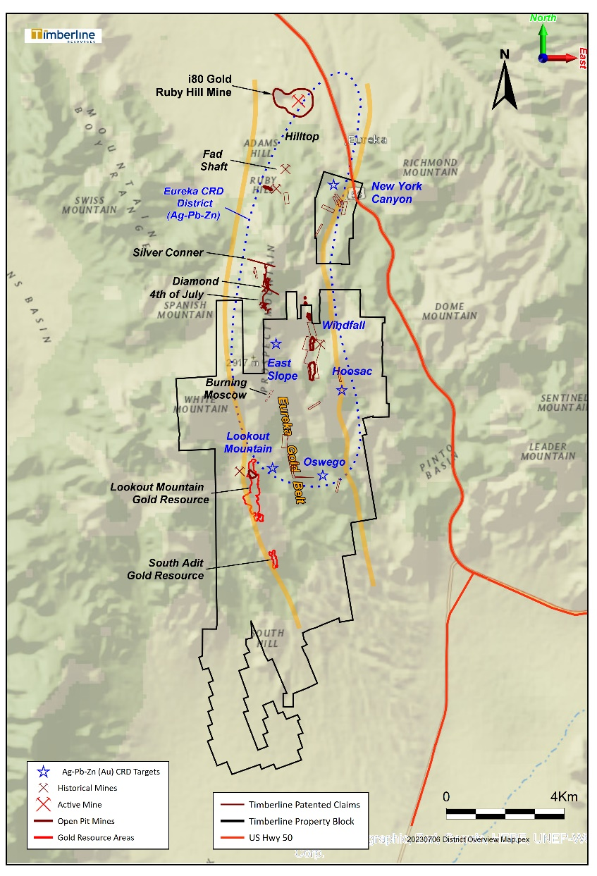
2023 PROPOSED WORK PLAN
New York Canyon
First drilling on new high-grade gold and CRD silver targets
Lookout Mountain
Infill drilling around higher-grade targets
Metallurgy on heap leach recovery
Waste rock and geochemistry studies
Geotechnical work for pit design
Biological surveys
Surface & groundwater study
Completion of the cultural and archaeological survey
Windfall Mine Trend
Drilling on patented claims to test oxide resource between pits
Advance new CRD targets along trend and downdip

Slide 10
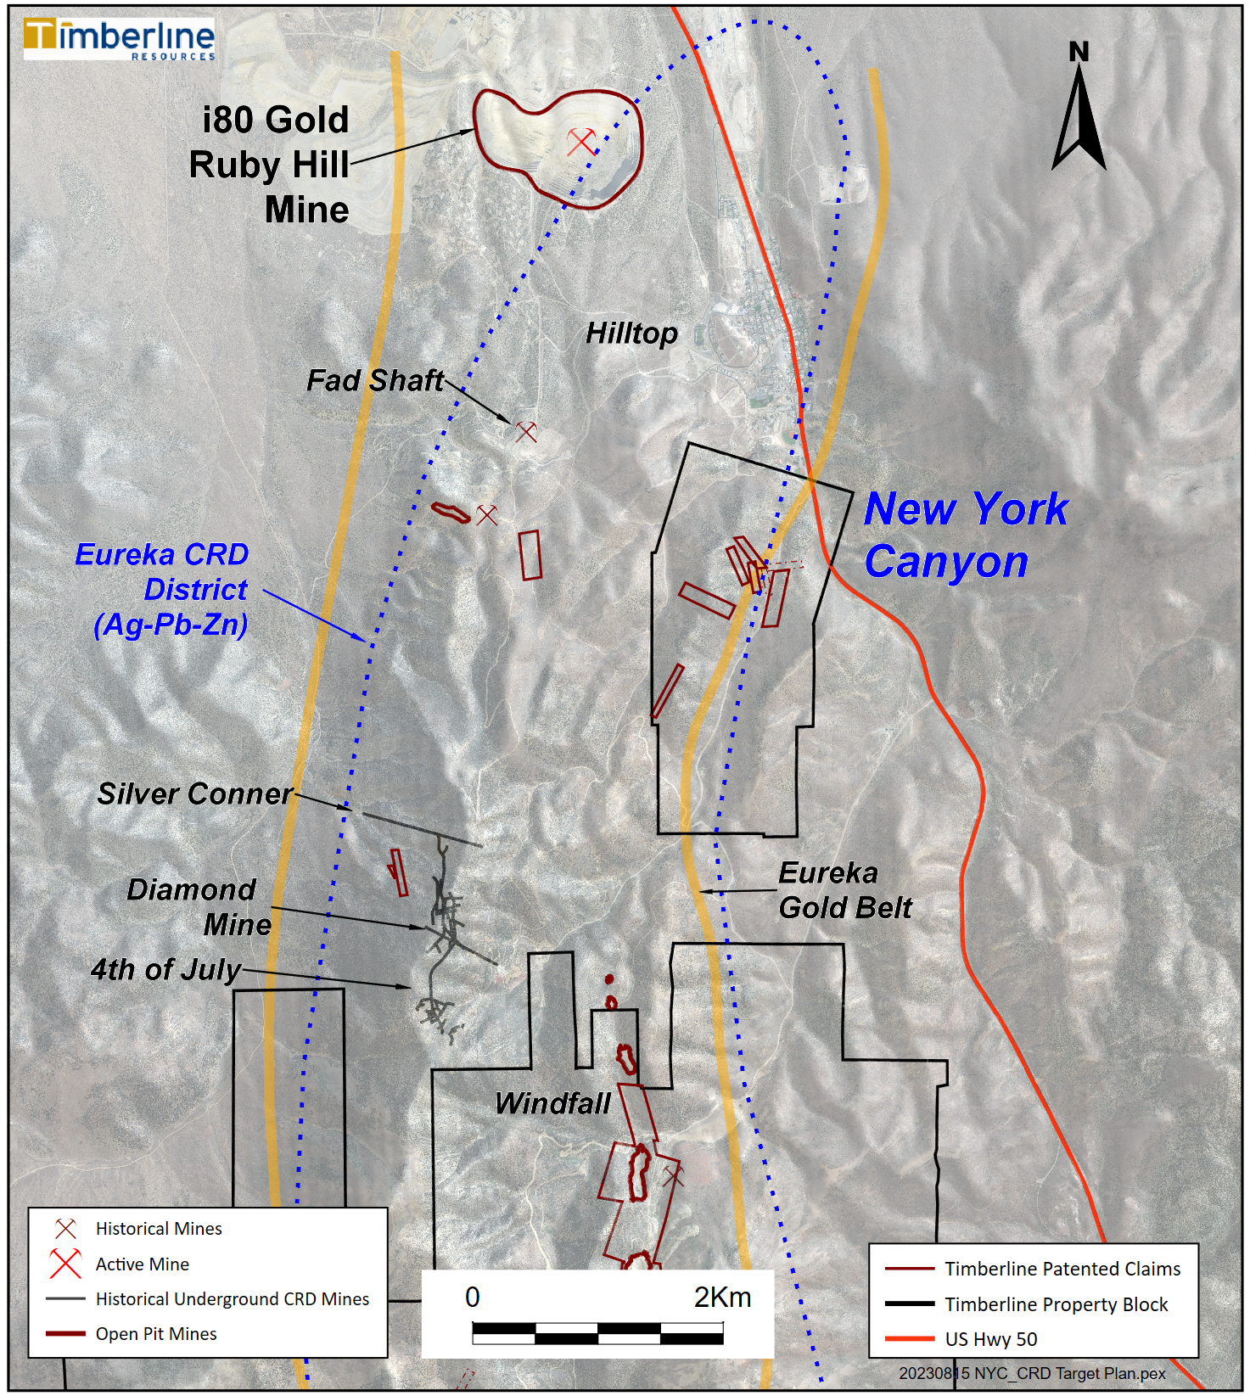
EUREKA PROJECT NEW CRD TARGET: NEW YORK CANYON
BLM and Patented Claim Block
Selected Rock Samples
Sample ID | Au (g/t) | Ag (g/t) | Pb (%) | Zn (%) | Cu (%) | Company
8150A | 55.00 | 246 | 0.76 | 0.57 | 0.29 | Timberline
8251 | 32.00 | 555 | 0.60 | 0.48 | 0.26 | Timberline
8173 | 22.50 | 178 | 0.49 | 0.31 | 0.14 | Timberline
8255 | 23.3 | 558 | 0.94 | 0.65 | 0.33 | Timberline
8150B | 14.95 | 251 | 0.50 | 0.25 | 0.15 | Timberline
667_NY | 0.09 | 750 | 0.43 | n/a | n/a | Historical*
8306 | 0.497 | 582.5 | 0.14 | 0.07 | 0.44 | Timberline
8253 | 1.93 | 299 | 0.68 | 0.57 | 0.35 | Timberline
8174 | 0.21 | 157 | 0.12 | 8.40 | 0.83 | Timberline
8315 | 0.53 | n/a | 7.16 | 0.38 | n/a | Timberline
8264 | 0.56 | 145 | 5.17 | 0.02 | 0.03 | Timberline
* - See Notes on Disclosure of Historical Estimates in News Release dated February 2, 2023
10
10

Slide 11
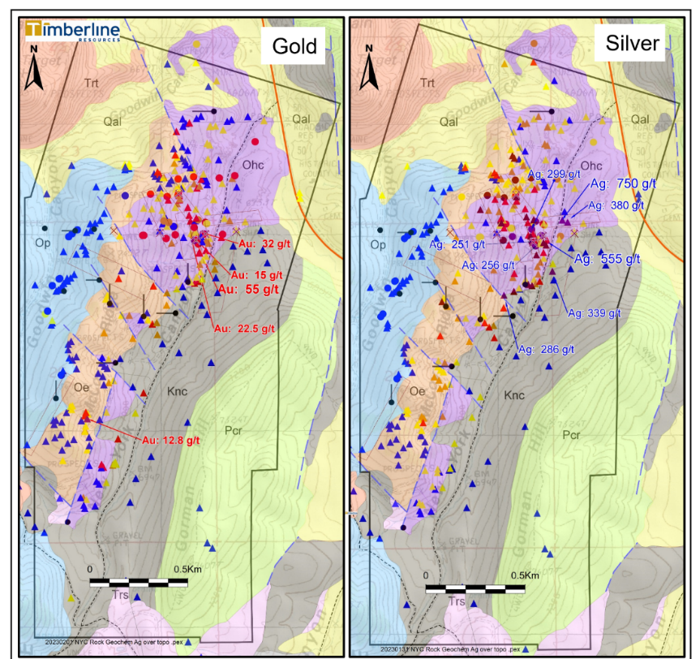
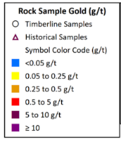
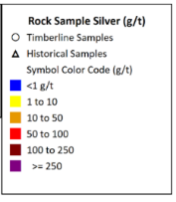
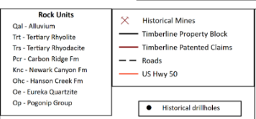
NEW YORK CANYON TARGETING
2023 Drilling Area
CRD silver-lead-zinc-copper in the Ordovician section
Carlin-type gold overlapping with CRD
Potential at surface and at depth

Slide 12
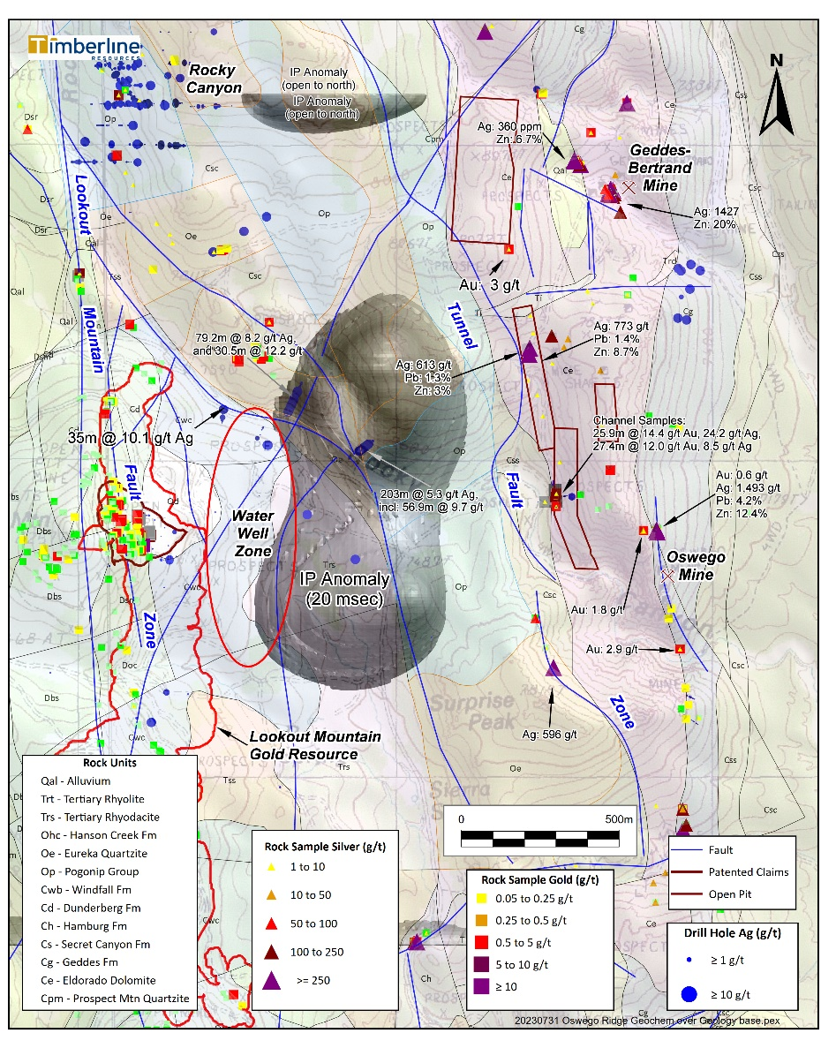
LOOKOUT MTN TO OSWEGO GOLD & SILVER TARGETS
Carlin-type gold along the Lookout Trend and downdip into the Water Well Zone (WWZ)
Silver-rich CRD style mineralization north and east of WWZ – Linked with IP Anomaly
Significant silver targets and historical mines north and northeast of Oswego Mine
CRD type geochemistry
Overlapping Carlin-type geochemistry
Rocky Canyon target (north of Lookout) hosts gold and silver in Ordovician rocks – which are an important host at i80 Gold’s Ruby Hill Mine

Slide 13
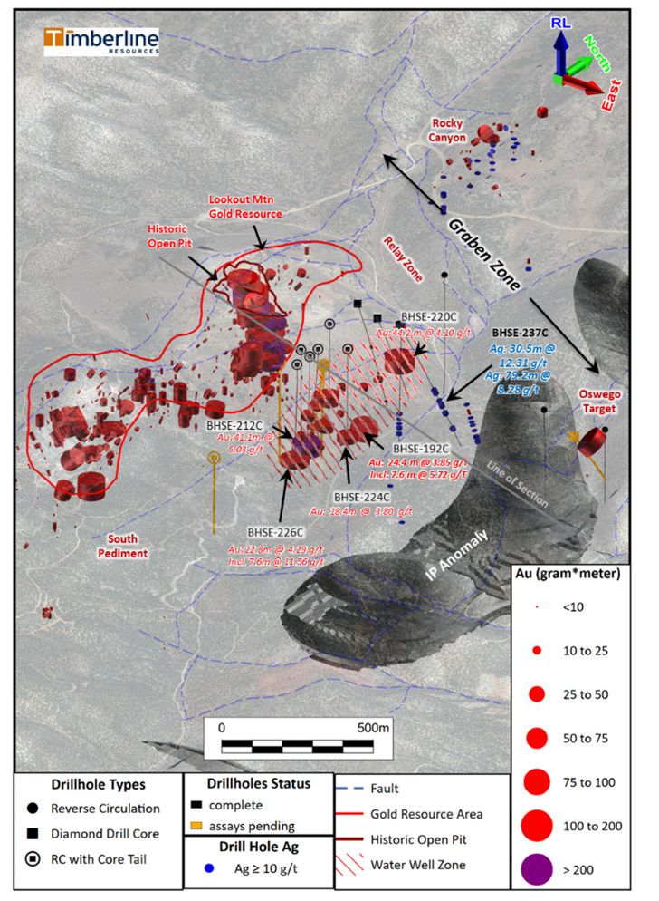
LOOKOUT MOUNTAIN to WWZ to GRABEN ZONE to OSWEGO
IP anomaly stretches for more than 2km – possible continuations to north and south
Major structural break between Ordovician and Cambrian sections
Graben is coincident with significant gravity low and mag low
Heart of anomaly remains undrilled, peripheral drill tests hit Ag-Pb-Zn-Au mineralization, hornfels, and dikes
Drill indicated fine-grained intrusive dikes associated with Ag-Pb-Zn – Dating underway (Cretaceous ?)
High-grade gold occurrences on both sides of Graben – Oswego and WWZ/Lookout Deep

Slide 14
LOOKOUT MOUNTAIN SCHEMATIC CROSS SECTION
Oswego Target
Surface Rock Chips:
86m of 12.4 g/t Au

Slide 15
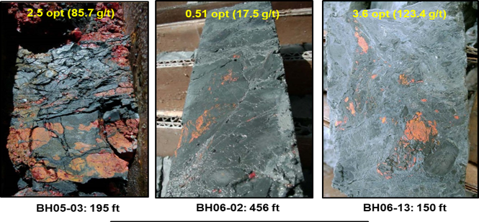
LOOKOUT MOUNTAIN TREND
Lookout Mountain and WWZ: Selected High-Grade Gold Intercepts⁽¹⁾
Drill Hole | From (feet) | Length (feet) | Gold (opt) | From (meters) | Length (meters) | Gold (g/t)
BH06-10 | 0 | 50 | 0.537 | 0 | 15.2 | 18.42
BH05-01 | 270 | 65 | 0.344 | 82.3 | 19.8 | 11.79
including | 275 | 25 | 0.641 | 83.8 | 7.6 | 21.98
BR-19 | 385 | 75 | 0.283 | 117.4 | 22.9 | 9.7
BHSE-029C | 391 | 58 | 0.349 | 119.2 | 17.7 | 11.95
BH06-07 | 406 | 92 | 0.217 | 123.8 | 28 | 7.44
BHSE-212C | 1,037 | 135 | 0.147 | 316.1 | 41.1 | 5.03
including | 1,042 | 65 | 0.277 | 317.6 | 19.8 | 9.49
BHSE-220C | 462 | 145 | 0.120 | 140.8 | 44.2 | 4.10
including | 462 | 75 | 0.182 | 140.8 | 22.9 | 6.24
including | 497 | 40 | 0.268 | 151.5 | 12.2 | 9.18
BHSE-176 | 70 | 50 | 0.294 | 21.34 | 15.24 | 10.09
BHSE-126C | 31 | 15 | 0.967 | 9.5 | 4.6 | 33.15
BH06-16 | 0 | 33 | 0.376 | 0 | 10 | 12.88
BH06-02 | 445 | 27 | 0.364 | 135.7 | 8.2 | 12.48
BHSE-226C | 1115 | 75 | 0.125 | 339.9 | 22.8 | 4.29
BHSE-151C | 506 | 9 | 1.023 | 154.3 | 2.7 | 35.07
BHSE-192C | 1,147 | 80 | 0.112 | 349.6 | 24.4 | 3.85
BHSE-224C | 1,042 | 100 | 0.075 | 317.6 | 30.5 | 2.56
BHSE-172 | 900 | 40 | 0.136 | 274.3 | 12.2 | 4.66
BH06-13 | 148 | 3 | 1.47 | 45.1 | 0.9 | 50.4
BHSE-187 | 875 | 25 | 0.222 | 266.7 | 7.62 | 4.49
BHSE-186 | 15 | 20 | 0.152 | 4.57 | 6.1 | 5.21
Drill thickness - True widths of intercepts have not been determined Red intervals were reported from 2020 - 2021 drilling program
On the Trail of High Grade
Recognition of high-grade gold zone associated with favorable stratigraphy and major structural zone, often oxidized at Lookout Mountain
Carbonaceous and siliceous breccias hosting majority of high-grade at Water Well Zone
Introduction of gold with sooty sulfides and As, Sb, Hg, Tl, and Zn pathfinder elements
¹Refer to Updated Technical Report on the Lookout Mountain Project, MDA, Effective March 1, 2013, Filed on SEDAR April 12, 2013 and numerous Company news releases

Slide 16
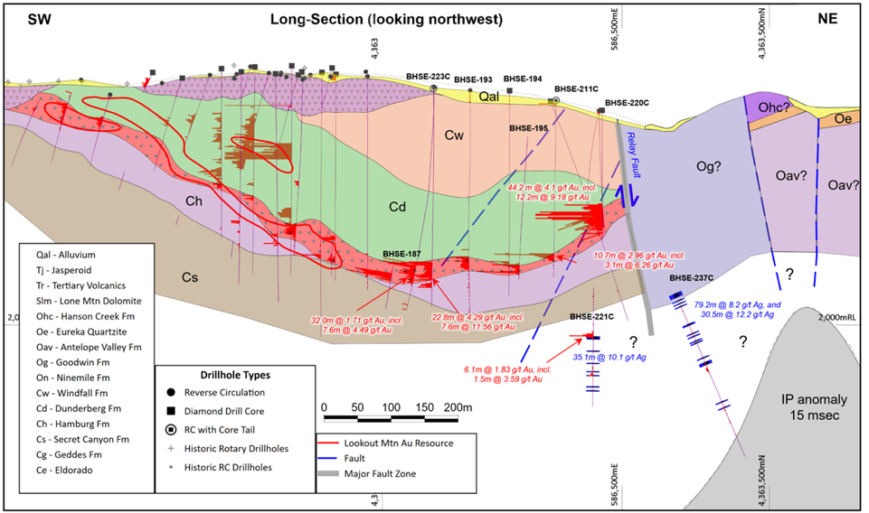
LOOKOUT RESOURCE TO WATER WELL ZONE
SSW-NNE Long Section Showing Resource and Water Well Zone
Dunderberg Shale is dominant host in both resource and WWZ
WWZ is downdip from resource – averages ~18m thick
WWZ is consistently mineralized at base of Dunderberg over a large area
Consistently anomalous gold at key contact for more than 1km
Resource Area
Water Well Zone
Silver Mineralization (shown in blue) associated with granites and IP anomaly

Slide 17
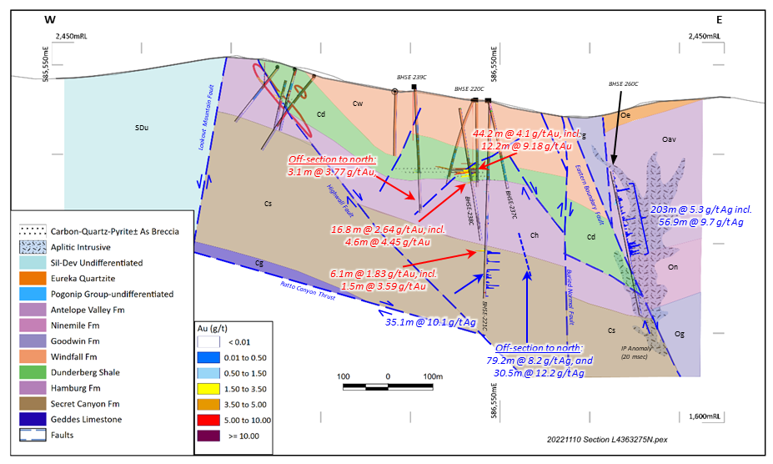
LOOKOUT RESOURCE TO WATER WELL ZONE
W-E Cross Section Showing WWZ North and Graben Targets
Structural High:
an important control on high-grade gold
Dunderberg Shale is dominant host at WWZ North
Well developed jasperoid with breccia and high As
Fault controlled upthrown block is key
Drilling to offset and undercut hit lower grades
More targets around structural high and into the graben zone
Resource Area

Slide 18
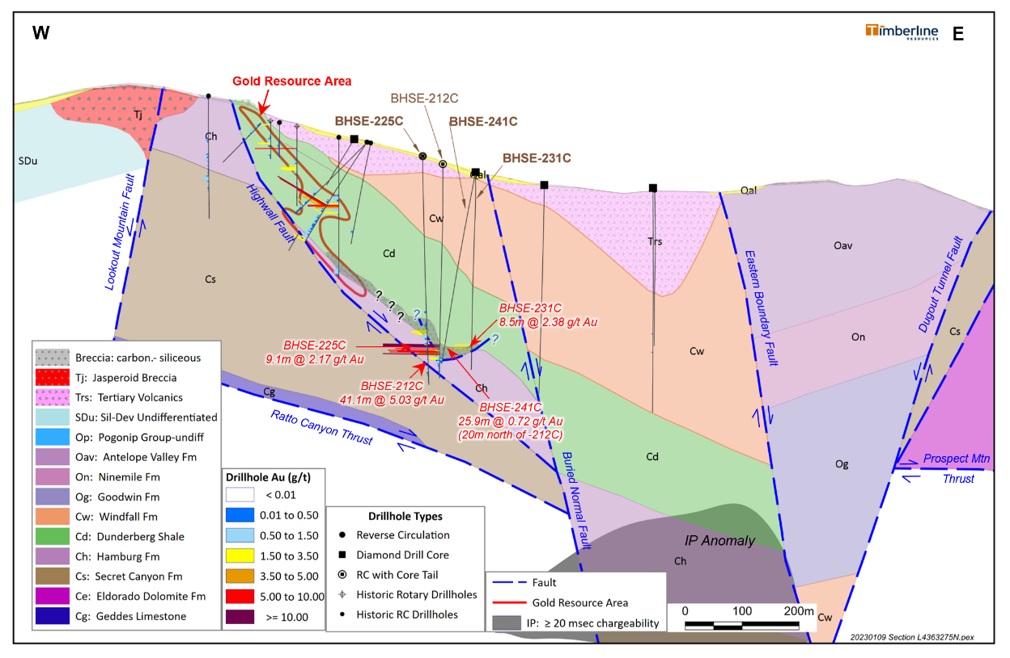
LOOKOUT RESOURCE TO WATER WELL ZONE
W-E Cross Section through WWZ South
Trough at Top of Hamburg:
an important control on high-grade gold
Well developed Carlin-style alteration at the base of Dunderberg and well into top of Hamburg
High-grade associated with breccia and argillization – no jasperoid, high arsenic
High-grade in localized trough – topo low
Offsets to north and west hit well developed alteration – much lower grade
Strong southern extension – 22.8m at 4.29 g/t Au 75m south of section

Slide 19
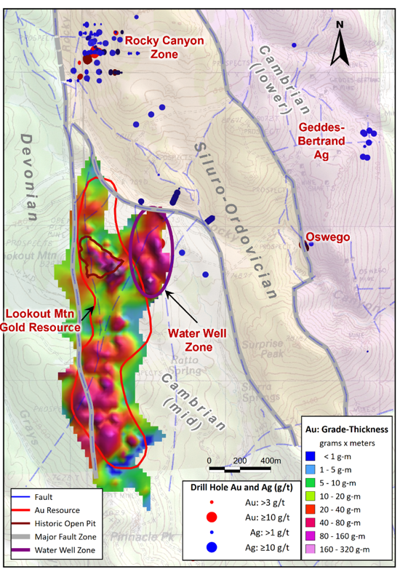
GRADE THICKNESS ON LOOKOUT TREND
UNDER TESTED
Thicker and higher-grade intercepts from core drilling better define the potential of the WWZ (Holes 192, 212, 220, and 226)
Last intercepts in Holes 225 and 231 confirm continuity but at lower grade (29m at 1.06 g/t Au) – Open to East and South
Faulting has offset and created apparent gaps, but Dunderberg – Hamburg contact remains consistently mineralized
Significant Ag-rich CRD system with intrusive rocks repeatedly drilled north of WWZ
Growth potential along eastern front of resource and downdip from Water Well Zone
Same pattern exists going to South Lookout – grade thickness improving to the east but UNTESTED DOWNDIP
Sections
Sections
UNTESTED
UNTESTED
UNDER TESTED

Slide 20
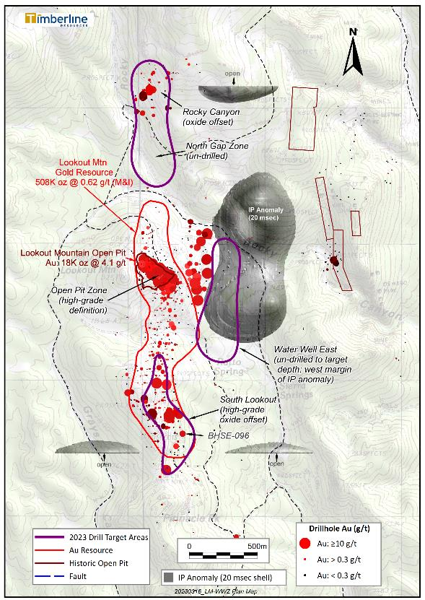
LOOKOUT MTN RESOURCE AREA 2023 DRILL TARGETS
Lookout and Lookout North Resource Area → Permitting:
Metallurgical evaluation and additional grinding and column tests
Drilling for infill, geotechnical and additional metallurgy
Waste rock management support
Surface and groundwater study: water table, monitoring wells, and sampling
Upgrade and pit constrain resource
Biological surveys
Completion of cultural/anthropology surveys (west side)
Exploration and Infill at Rocky Canyon and Water Well East:
Exploration in gap between Lookout and Rocky Canyon
Expansion of WWZ to the east and south
Testing of IP Anomaly: CRD and CTD Potential
Within PoO with more than 250 permitted drill sites
Exploration and Infill at South Lookout:
Evidence of massive alteration system at surface and moderate depth
Local pockets of stronger grade and no drilling downdip
Several clusters of higher-grade needing follow-up:
BHSE-096 (2011): 61m at 1.54 g/t gold (mostly in Hamburg oxide)
Significant gap in drilling between South Lookout and South Adit
Long Section
Cross Section

Slide 21
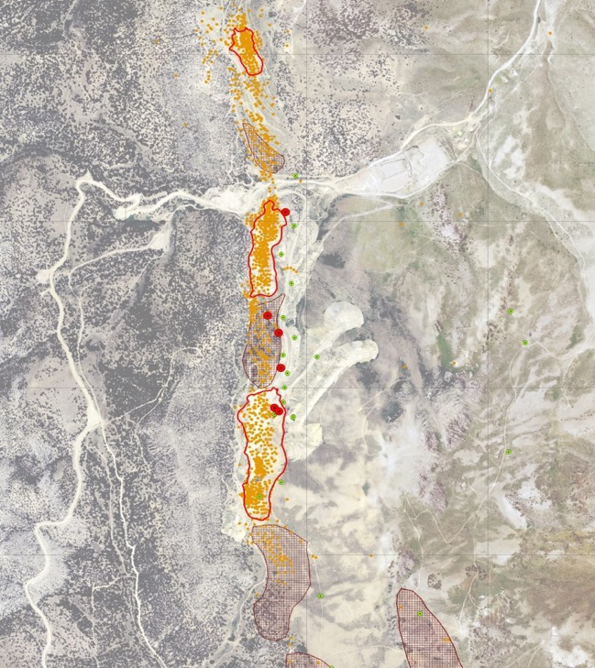
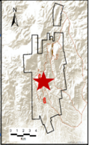
EUREKA PROPERTY: WINDFALL MINE TREND
Golden Lake Results:
67.57m at 2.37 g/t Au, including
26.37m at 5.38 g/t Au
South Paroni Pit:
~31,800 Ounces Produced
Historic Production and Modern Drill Intercepts
BHWF-038
24.4 m @ 0.32 g/t
100% Timberline Ownership (patented claims)
Windfall Mine (1975-1984) produced >100,000 oz of gold
Among industry’s first stand-alone open pit heap leach operations
Excellent historic gold leach recovery on run-of-mine ore
2.7 km major structural zone with coincident gold mineralization
Timberline drill intercepts beneath and between pits, plus new IP anomalies to east and west
Newly developing and undrilled CRD targets based on coincident silver anomalies and IP chargeability highs
Windfall Pit:
32,077 Ounces Produced
BHWF-037
27.4 m @ 2.20 g/t incl.
13.7 m @ 3.68
BHWF-040
24.4 m @ 3.04 g/t incl.
6.1 m @ 8.79
BHWF-041
18.3 m @ 1.24 g/t
BHWF-036
12.2 m @ 1.26 g/t
BHWF-039
10.7 m @ 0.46 g/t
N
Rustler Pit:
~50,000 Ounces Produced
400 m
1,500 ft

Slide 22
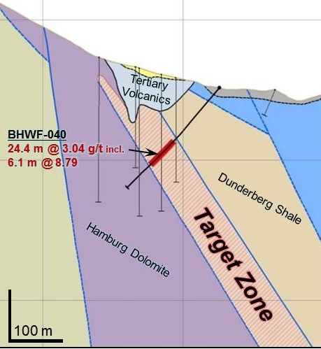
EUREKA PROPERTY: WINDFALL MINE TREND
40 gold-bearing surface samples⁽²⁾ within and south of historic Windfall Pit
maximum 13.1 g/t (0.382 opt)
6 samples >3.0 g/t (0.088 opt)
10 samples >1.0 g/t (0.029 opt)
17 samples >0.25 g/t (0.007 opt)
Drill Hole | From (feet) | Length⁽¹⁾ (feet) | Gold (oz/ton) | From (meters) | Length (meters) | Gold (g/t)
BHWF-036 | 290 | 40 | 0.04 | 88.4 | 12.2 | 1.26
BHWF-037 | 185 | 90 | 0.06 | 56.4 | 27.4 | 2.20
including | 185 | 45 | 0.11 | 56.4 | 13.7 | 3.68
BHWF-040 | 290 | 80 | 0.09 | 88.4 | 24.4 | 3.04
including | 305 | 20 | 0.26 | 93.0 | 6.1 | 8.79
BHWF-041 | 230 | 60 | 0.04 | 70.1 | 18.3 | 1.24
Cross-section between Rustler and Windfall Pits
W
E
Surface Sample⁽²⁾ | Gold (oz/ton) | Gold (g/t) |  | Surface Sample | Gold (oz/ton) | Gold (g/t)
18WF-009 | 0.05 | 1.72 |  | 18WF-047 | 0.225 | 7.71
18WF-011 | 0.031 | 1.05 |  | 18WF-049 | 0.008 | 0.275
18WF-013 | 0.036 | 1.25 |  | 18WF-051 | 0.011 | 0.386
18WF-034 | 0.009 | 0.303 |  | 18WF-053 | 0.018 | 0.61
18WF-035 | 0.088 | 3.02 |  | 18WF-054 | 0.089 | 3.06
18WF-036 | 0.382 | 13.1 |  | 18WF-055 | 0.094 | 3.22
18WF-037 | 0.021 | 0.711 |  | 18WF-056 | 0.074 | 2.52
18WF-039 | 0.012 | 0.408 |  | 18WF-062 | 0.119 | 4.08
18WF-041 | 0.027 | 0.927
*Assays were determined by ALS USA Inc. from grab samples. The samples were crushed and pulverized and a fraction was selected for analyses. Gold was determined by 30 g Fire Assay with an Atomic Absorption finish. Samples assaying over 10g/t gold were re-assayed and completed with a gravimetric finish.

Slide 23
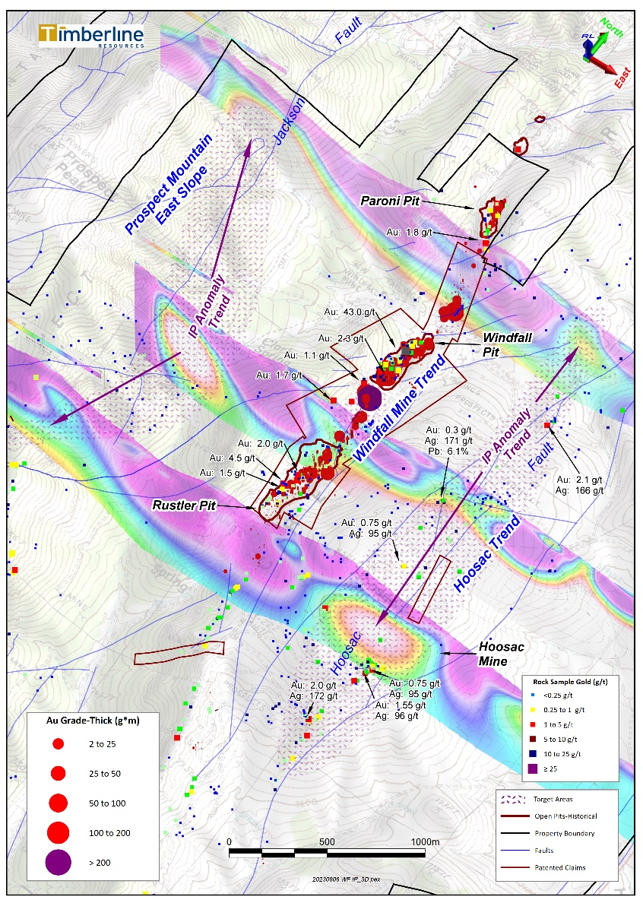
EUREKA PROPERTY: WINDFALL & HOOSAC TRENDS
Carlin-type gold and CRD type silver
Patented claims facilitate rapid permitting for drilling
Oxide mineralization remaining at surface (confirmed in 2022)
Near-surface infill drilling targets
IP geophysics and surface sampling suggest the presence of CRD silver-rich system and overlapping Carlin-type gold
Silver in rock chip samples of 96 g/t, 166 g/t, and 271 g/t on the Hoosac Trend
Deeper targets associated with downdip projection of favorable host rocks into IP anomaly
Addition target on east slope of Prospect Mountain – IP anomaly trend aligns with Jackson Fault

Slide 24
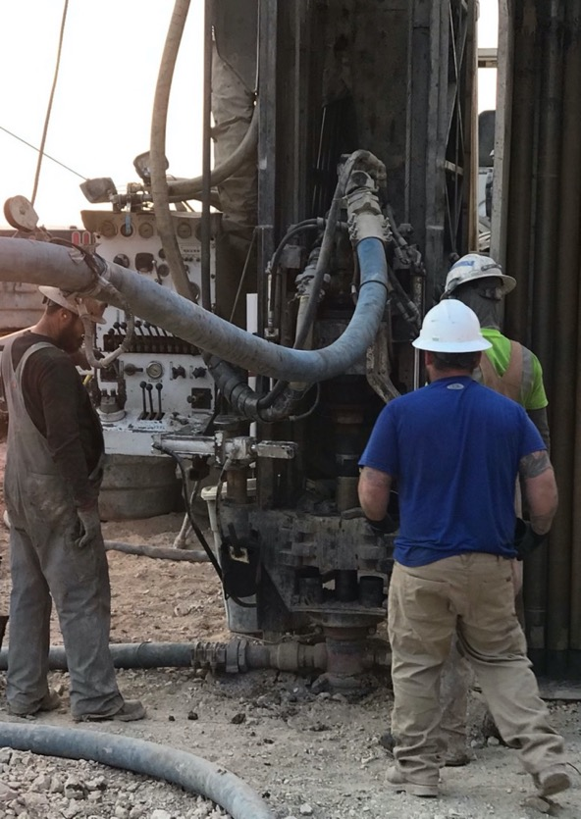
Patrick Highsmith
President & CEO
P: 2 0 8 . 6 6 4 . 4 8 5 9
EMAIL: highsmith@timberline–resources.com
www.timberline-resources.com

